Slide 1
Lab 6: Oak creek

Slide 2
Lab roadmap
YOU ARE HERE:
Oak creek data collection
Due Today
Lab 6 pre-lab
WHERE WE’RE GOING:
Data analysis Due next week
Sunday: data entry Tuesday: Lab 7 pre-lab Annotated bibliography

Slide 3
Waiver
Sign the waiver if you didn't sign it yet!

Slide 4

Individual Annotated Bib.
Find a peer reviewed scientific article related to your research question.
Read the article, then write your summary following the format of the example provided on canvas.
If you follow that format you will notice that the entire summary is one page!
Be careful copying citations from online – they are likely in a different format. See Canvas for citation help!
Submit to both the assignment page and your group discussion board!

Slide 5
Individual Annotated Bib.
Find a peer reviewed scientific article related to your research question.
Read the article, then write your summary following the format of the example provided on canvas.
If you follow that format you will notice that the entire summary is one page!
Be careful copying citations from online – they are likely in a different format. See Canvas for citation help!
Submit to both the assignment page and your group discussion board!
MOST COMMON MISTAKES:
- Not choosing a peer reviewed scientific article
- Not following the example format results in many components missing.

Slide 6
Journal article:
See “citations are hard” document on Canvas for citation guidance.
GENERAL FORMAT
Authors listed with last names followed by first initial(s). Year of publication. Title. Journal published in journal edition(volume if there is one): pages.
EXAMPLES
Example with one author: Lynn B. 2022. Cats are incredible, but especially Pancake. The Journal of Cats Are Awesome 2: 23-46.
Example with two authors: Pride W and Lightyear B. 1995. To infinity and beyond. The Secret Life of Toys 11: 22-33.
Example with three authors: Potter H, Granger H, and Weasley R. 2000. How to tickle a whomping willow. The Journal of Advanced Magic 6: 26-42.
Example with greater than three authors: Brown M, Bunton E, Halliwell G, et al. 1996. Spice up your life. Wannabe Journal 97: 1-33.

Slide 7
Questions?

Slide 8
Today’s activities

Slide 9

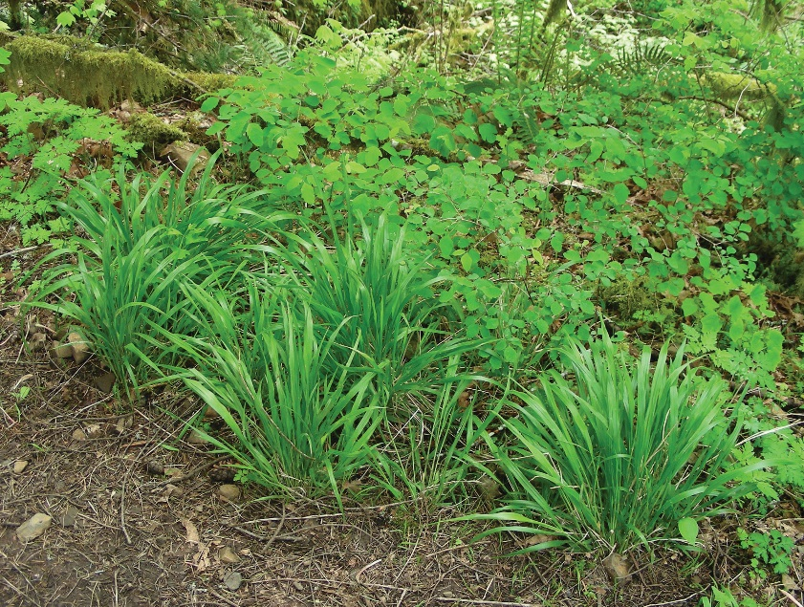
BI223 Course false brome removal
Oak Creek is managed by OSU, and the watershed has been invaded with False brome.
You’re participating in a course experiment spanning many years examining the effectiveness of hand pulling false brome.

Slide 10
Project timeline
TODAY
Collect data
THIS WEEK
Enter data into spreadsheets. All labs will share the data.
NEXT WEEK (in lab)
Analyze course wide data
Work on presentations
WEEK 8
Rough draft due
Group presentations

Slide 11
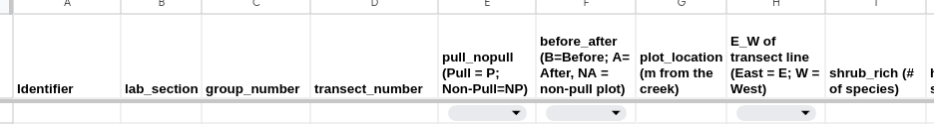
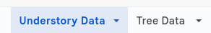
Data entry: Due Sunday!
Each group should add the data they collect today into the Lab's spreadsheet (available under Lab Materials on Canvas);
I will clean it, add to the Class spreadsheet and then make it available so you can analyze it next week!

Slide 12
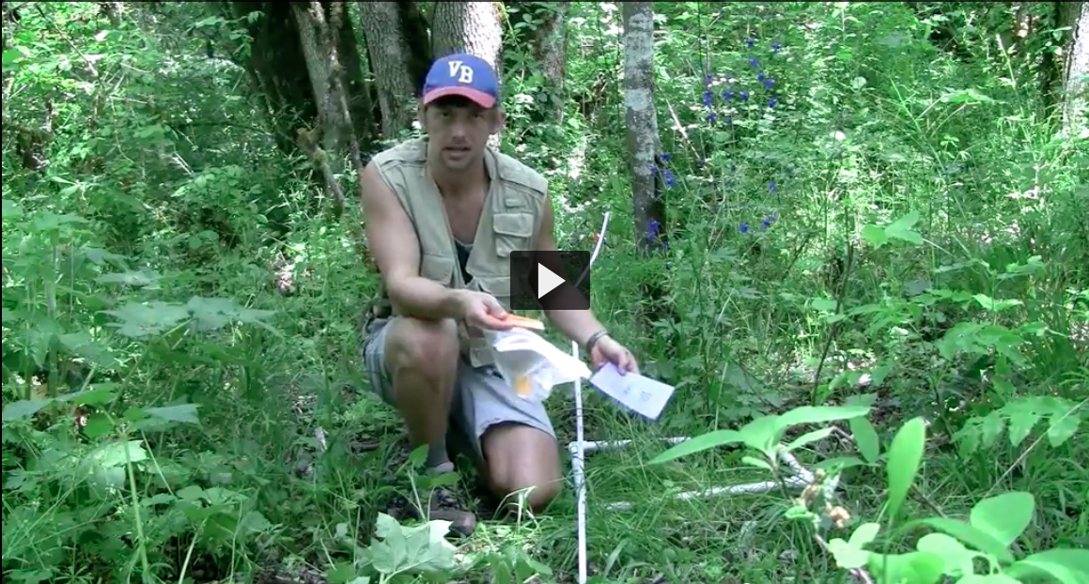
Protocol video

Slide 13
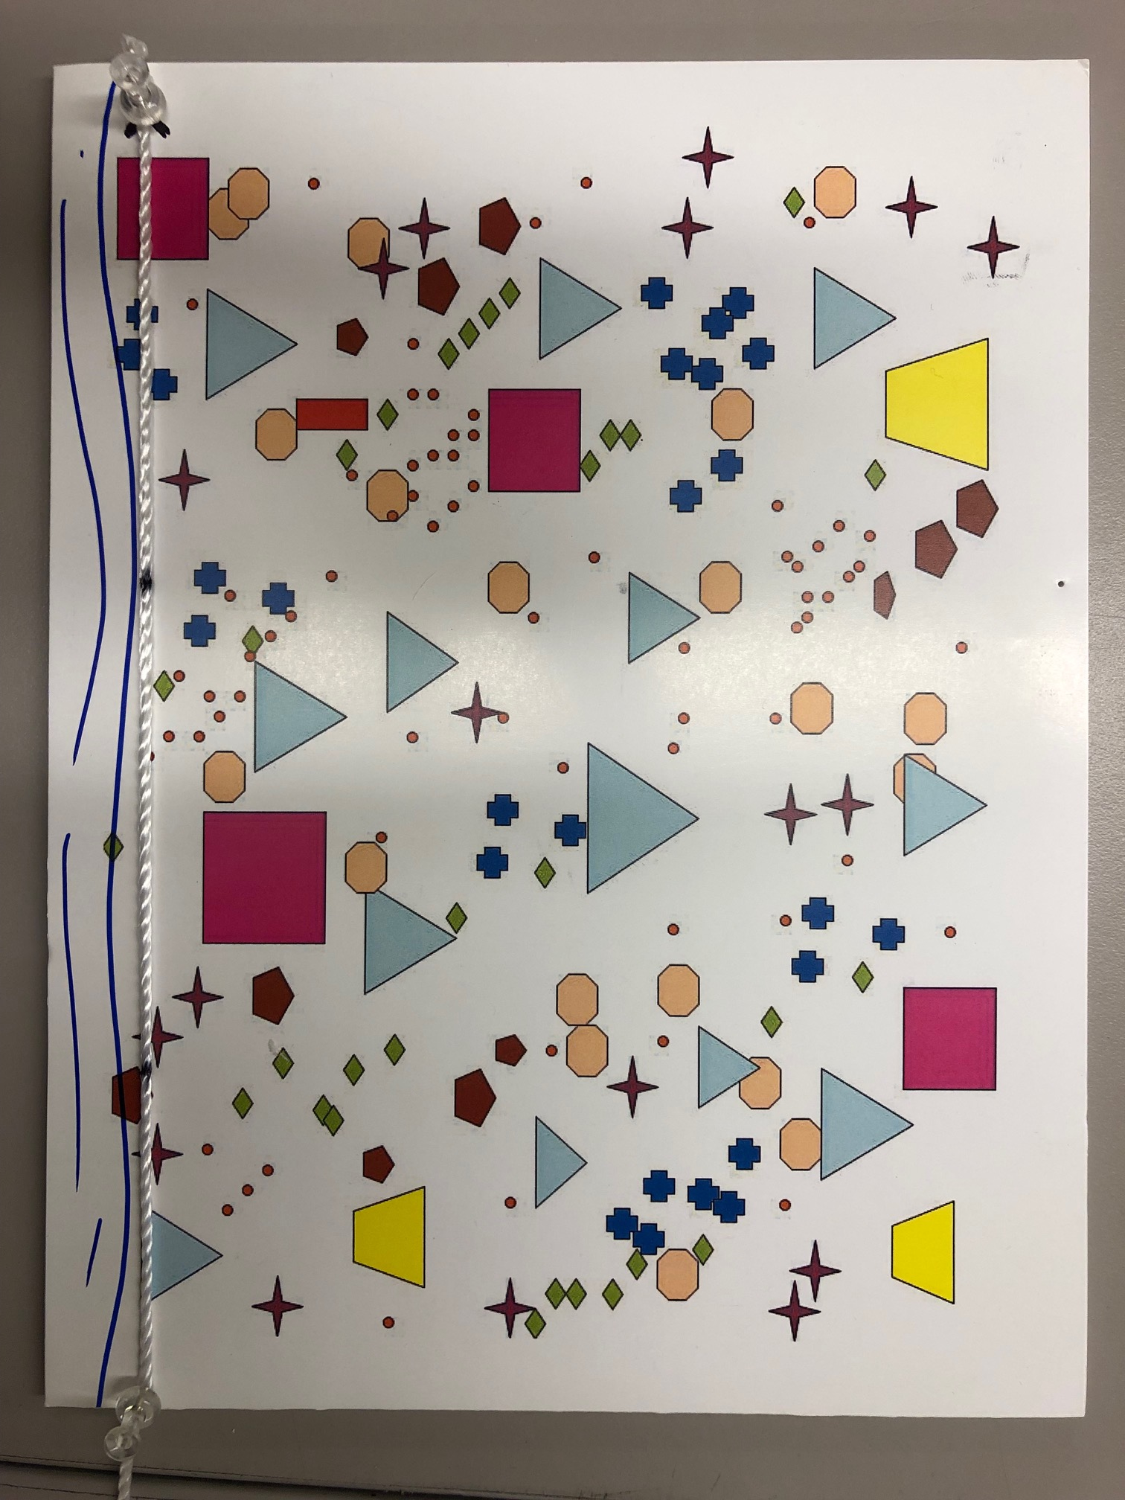
data collection
The base and measurement transects will already be laid out.
Place your quadrat so the bottom edge is at your quadrat location distance.
Take measurements within quadrat for percent coverage and species diversity data.
0 m

Slide 14
data collection
Plot location
The transect number is the distance along the base transect: for our class the transect number = 6
The plot location is the distance along the measurement transect.
Riparian habitat are plot locations of 5 or less m
Transect number

Slide 15
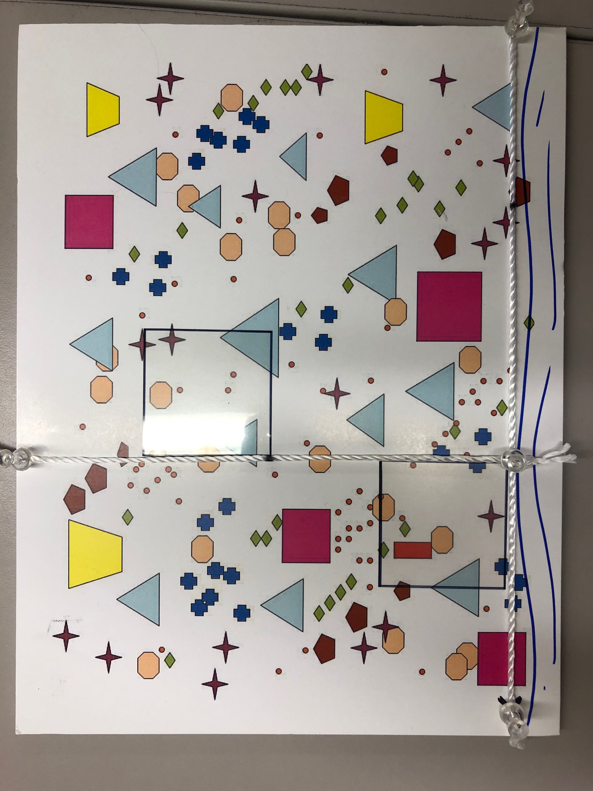
data collection
For trees:
Use the point on the measurement transect that intersects the top of the quadrat to measure distance from.
Don’t forget to repeat for each direction!
If a tree is more than 20m away, record as 0m.

Slide 16



data collection
For trees:
To ID trees
We will provide a dichotomous key
There’s an app for that

Slide 17
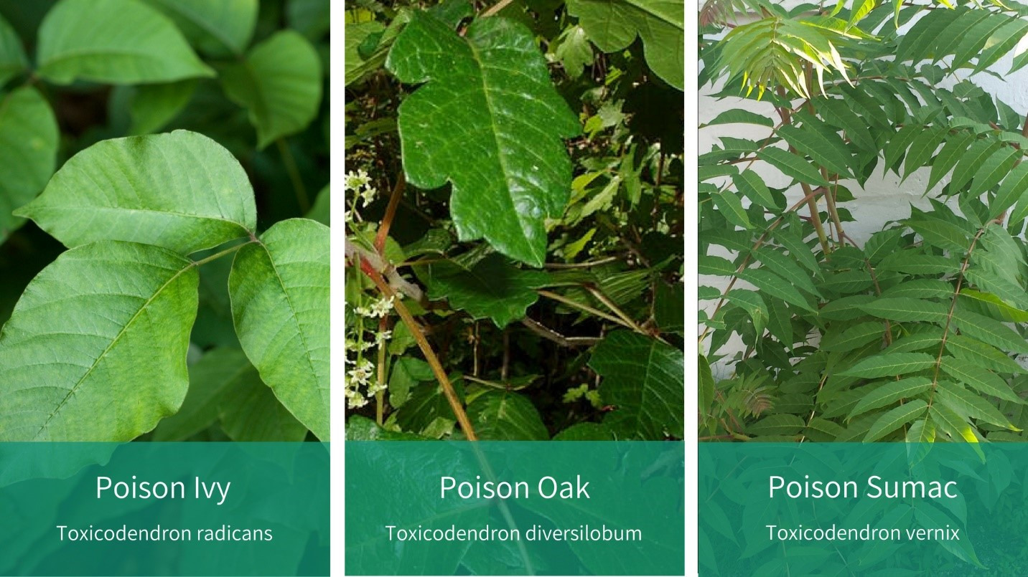
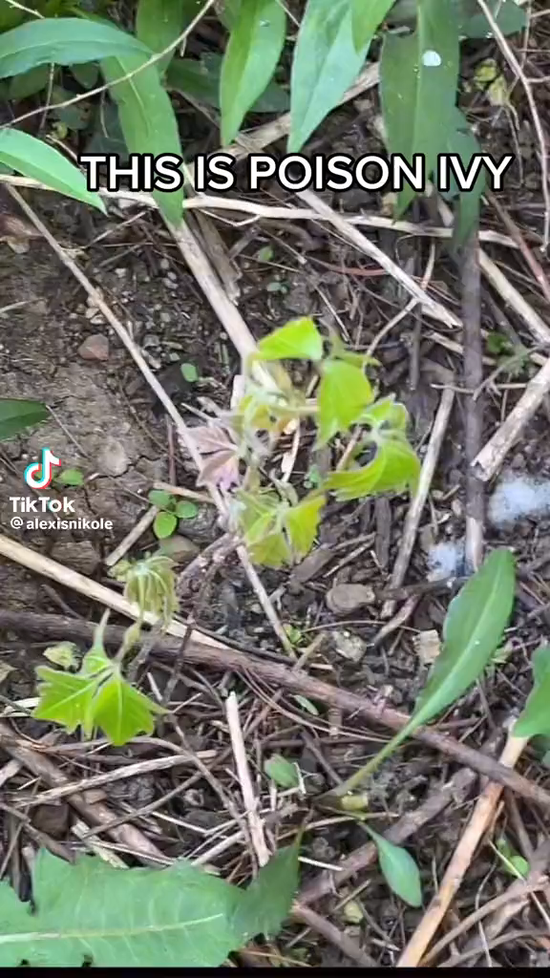
Don’t touch poison oak or poison ivy!
If you’re unsure, leave it alone.
We will provide gloves.
We have special soap.

Slide 18
Your quadrats
Table number | Quadrat 1 | Quadrat 2 | Side of transect line
Table number | m from stream | m from stream
1 | 0 | 12 | W
2 | 1.5 | 13.5 | E
3 | 3 | 15 | W
4 | 4.5 | 16.5 | E
5 | 6 | 18 | W
6 | 7.5 | 19.5 | E
7 | 9 | 21 | W
8 | 10.5 | 22.5 | E

Slide 19

Before leaving the field
Show data sheets to TA and return equipment before leaving This is your ‘signature’ for the week
Only one person needs to enter the data for the group
Do not put units in the cells

Slide 20
TO GET POINTS FOR LAB TODAY
Must have your data sheets checked before departing Oak Creek AND have the data entered in google sheet by Sunday at midnight

Slide 21

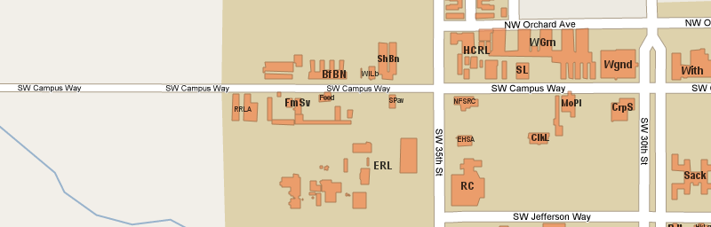
Out to the field!
Meet near Oak Creek:
Follow SW Campus Way west (approx. 20 min walk)
Go past campus buildings and barns
Look for a white truck parked on the side of the road.
Meet at covered bridge.

Slide 22
Questions?

